Slide 1
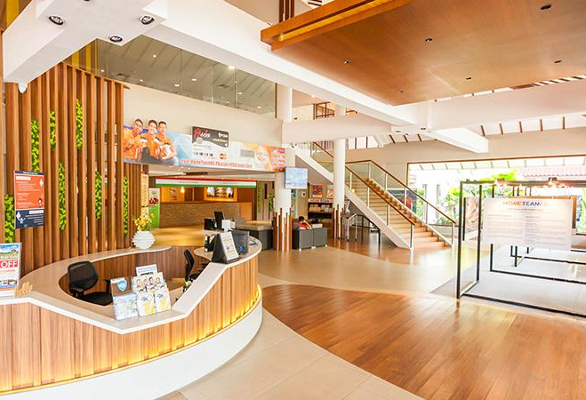

CAMPAIGN PROPOSAL

Slide 2


Smart Objectives:
To raise awareness about HomeTeamNS’s Bukit Batok club house among millennials aged 17 to 27.
Increase the number of likes and followers of HTNS social media pages (Facebook and Instagram) by 10% through our social media campaign and event on 12 August 2017.
Notes:
To raise awareness about Home TeamNS’s Bukit Batok club house among millennials aged 17 to 37 and to also increase the number of likes and Followers of HTNS social media pages by 20% through a__ day long event and our social media campaign.
HTNS IG - 1500
HTNS FB - 20k
How r we gg 2 start ours
My stories are all at big idea slide
I start of by asying your names, and “im going to get a little technical at the start but bear with me”

Slide 3

Key message:
To educate the
public on what
our NSmen go
through in a fun way.
Notes:
Rationale: Since our big idea mimics the real life work that our NSmen go through, it educates the participants by instilling elements of fun through gaming about how tough and challenging the job might be, creating a new sense of appreciation for the NSmen.

Slide 4

Our Big Idea:
One-stop Centre
for Fun!
Notes:
NOTES FOR SYUK:
Talk about mall, have this but dont have that. Have this, but dont have that.

Slide 5

HTNS’
ULTIMATE
NERF
BATTLE
Notes:
Police and thief story (Primary school, shoot guns, dunearn, laser quest, now next level).
Why: Relive their past inside NS (shooting range) or (childhood).
What: Getting friends together, working as a team, reunite.
How:

Slide 6
Mechanics
Qualifying Rounds
Top 5 Teams
Ultimate
NERF
Battle!
HomeTeamNS Bukit Batok
Saturday
12th August 2017
Notes:
Since its a large scale battle, not every team will have the chance to play.
Like any other HomeTeamNS men, they actually have to train first before going into a combat.

Slide 7
Qualifiers:
#1 Roll The Hose
#2 Changing Uniform
#3 Obstacle Course
Notes:
It will act as a build up to the main event. Teams who win these telematches will stand a higher chance of playing the final battle. Only 5 teams will be able to make it to the main battle.

Slide 8






Finals:

Slide 9

SPONSORSHIP

Slide 10

Why HASBRO?
*Reputable Name
HomeTeamNS will gain more recognition from working
with the third largest toymaker in the world.
*Huge Following
Hasbro Singapore’s Facebook account has over 32K likes. HomeTeamNS
can leverage on their following.
*Open new opportunities for HomeTeamNS
If Hasbro is satisfied with the relationship with HTNS, there will be more future partnership deals that can arise from the sponsorship.

Slide 11
What’s in it for
HASBRO?
We will be placing Hasbro’s logo on all our
collaterals. Through this there Hasbro will be
able to garner greater exposure.
There will be a brand mention by the emcees on the
actual day of the event.
There will be product placement in our pre-publicity videos
and collaterals.
We will mention and promote Hasbro’s products and services
through our social media posts.

Slide 12

SPONSORSHIP
ALTERNATIVE
Notes:
Sharon

Slide 13
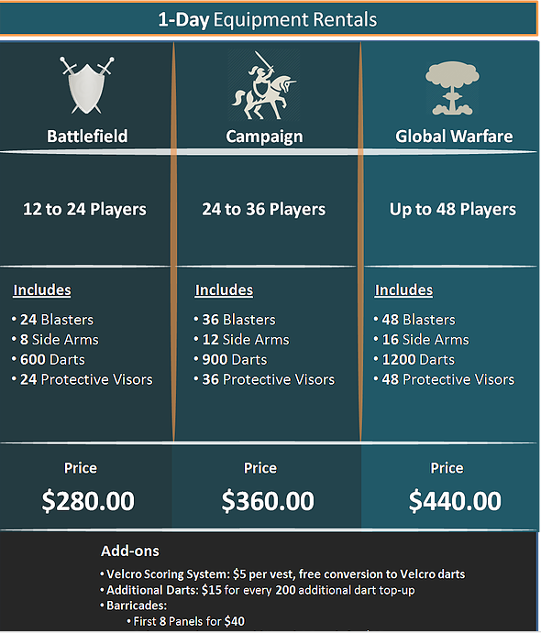
HIRED GUNS
Notes:
So if our sponsorship request to Hasbro is unsuccessful, we will be renting the equipment from hired guns and we will choosing this package

Slide 14

Target
Audience

Slide 15
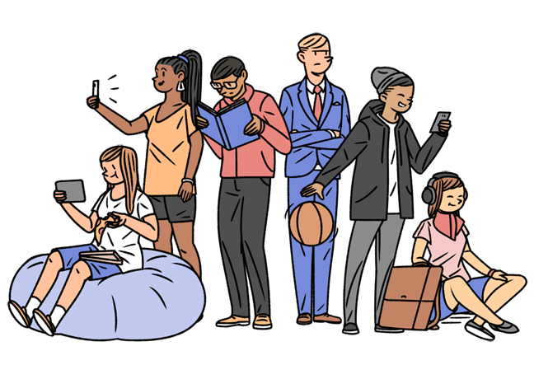
Target Audience//Why it will
appeal to them.
Primary Audience
Millennials aged 17 to 27 Men and women who are getting ready for NS/ are in NS/ just finished their NS They enjoy spending time with their friends and having an opportunity to run around and have some fun will be appealing to them. It would also be a good way for them to take a break from their hectic school/work/NS life
Notes:
Sharon so here’s our primary target audience we were initally told to reach out to millenials aged 17-37 but we decided to narrow it down to 17-27 as this event will suit them better

Slide 16
Target Audience//Why it will appeal to them.
Secondary Audience
HomeTeamNS members. We wanted to extend our invitation for this event to our existing members too as our a clubhouse is a recreational centre and it is often visited by groups of friends and families. Since the most frequented facility is laser tag we also believe that our members will enjoy this event as it is something similar
Notes:
sharon

Slide 17

IMC TOOLS

Slide 18
SOCIAL MEDIA | Youtube will be a platform for all of our promotional videos of HomeTeamNS’ facilities. Facebook and Instagram will be used for the social media campaign
DIRECT MARKETING | EDM will be sent to promote our big idea, which is the event. It will be sent to our existing members. Their email addresses will be retrieved from Hometeamns database
PUBLIC RELATIONS | Send media kits to influencers such as NOC, Jian Hao, Wah Banana!, The Smart Local, Xavier Lur. Provide them with a free pass to access all our facilities for a week Invite TNP, Today to attend the event in hope to attain media coverage
Notes:
Here are the IMC tools that we will be using. We will be using SM, Direct Marketing and PR
FREE pass- so they will have a rough sensing on what the clubhouse is like

Slide 19

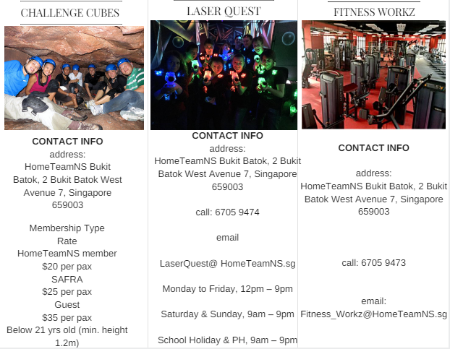
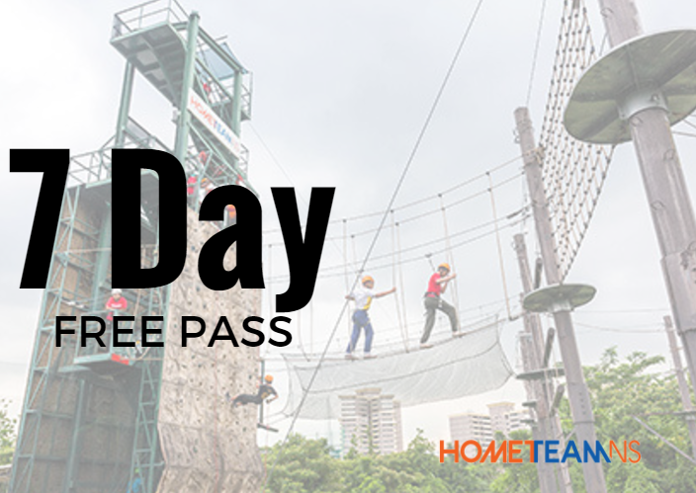
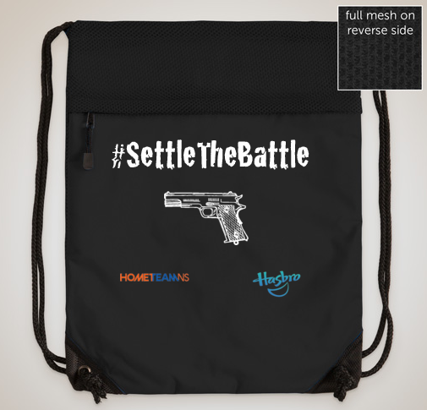
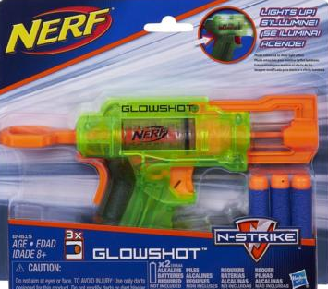
Kit:
Media
Notes:
Sharon this our media kit. It comes in a form of a drawstring bag and It will be sent out to the social media influencers. It will include our 7 day free pass, a mini nerf gun, htns frontline magazine and a brochure highlighting the facilities of HTNS bukit batok

Slide 20
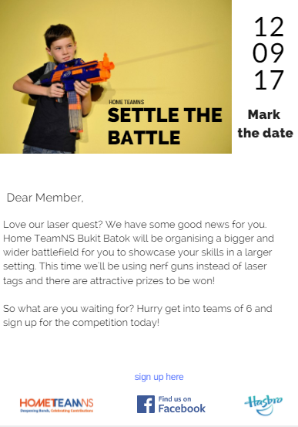
Example of EDM
Notes:
sharon

Slide 21

Example of
social media
poster
Notes:
Sharon heres an exmple of our social media poster, it will provide details of our event and encourage them to sign up for our event.
Gant Chart

Slide 22
Outline of videos
Pre-publicity | Teaser video: showing NSmen gearing up for “war” but it is actually our Nerf battle. Another video will showcase more on HTNS’ facilities. (Know your Battlefield) Video style will be dramatic
Instructional video | In the video, there will be instructions on how to sign up for the game, how to get there and how the nerf battle will go. Video style will be based on humour
Post-publicity | This will be a video showcasing the highlights during the event Video will be vlog style
Notes:
pre-pub : close up shot of them smearing face paint on

Slide 23
Video Campaign
Appeal: Emotional/ inspiring appeal
Storyline: Ask a series of questions
Example of questions:
Kids
Asking them what they want to be in the future
Do you feel safe having NSMen guarding singapore
Getting kids to react to actual operations video
Adult
What was a life changing experience you had as a policeman/fireman
What is something you wish people knew about your job
Do you think you spend enough of time with your family?
Do you think hometeamNS helps make it easier for you to spend time with your family

Slide 24
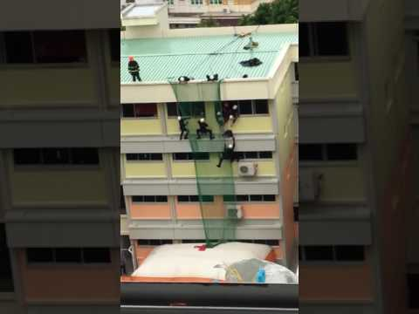
Example of operations video:

Slide 25

FOLLOW UP….
Steps to Participate:
Like and share the Video
Tag an SCDF/SPF member you know
Tell us why you appreciate them
Stand a chance to win: A pair of movie tickets

Slide 26
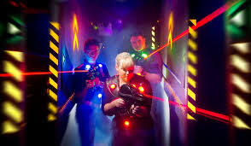
Social media contest
> Follow up post from “Know your battlefield” video
> Zoomed in photos of places in the clubhouse will be uploaded on Facebook and participants have to guess where the location is.
> The correct answer accompanied by the most creative comment as to why they deserve to be the winner will stand a chance win HomeTeamNs vouchers
Notes:
This will help them to rmb what we said in the prev video and also get people who have not watched the video to watch it. One good way to garner more views for our video and increase engagement.

Slide 27

Hashtags:
#settlethebattle
#HTNS
Notes:
Sharon thses are main hashtags that we’ll be using to reinforce our theme and the nerf battle event.

Slide 28

Budget - Marketing
EDM | Free
Prizes | $400
Promotional videos | $100
Media kit (info about our event and a nerf gun) | $200
Notes:
nimi

Slide 29

Budget - Actual Event
Set up of big idea (if we do not get a sponsorship) | $1000
Food catering Service | $300
Manpower | Free
Notes:
nimi

Slide 30
Grand Total
$2,000
Notes:
nimi

Slide 31
Timeline
Getting equipments
production
Blast out EDM
Send PR kits
Promotional videos
More Promotional videos & social media contest
Settle the battle
June 2017
June 2017
July 2017
July 2017 August 2017
12 Aug 2017
Notes:
10 july - start the posts
Last day - 14 aug

Slide 32
Event rundown on 12th August
Time | Activity
1130-1200 | Registration
1200-1230 | Briefing
1230-1430 | Roll the Hose/ Changing uniforms/ Obstacle Course
1430-1500 | Refreshment
1500-1530 | Instructional video
1530-1430 | Settle the battle
1430 | Home sweet home
Notes:
Sharon telematch

Slide 33

Follower count | Instagram and UNUM*
Like count | Facebook analytics and UNUM*
Share count | Facebook analytics
Comments | Facebook analytics and Bag of words
Views | YouTube
Subscribers | YouTube
Attendees | Evaluate if we have met our target of 90 attendees
Evaluation
Notes:
Sharon UNUM- is an app which will track down our social media progress just like fb analytics but its

Slide 34
Thank
You!
Any Questions?

Slide 35
References

Slide 36
Big idea (How To Play)
Bomba SG
(Gym)
Special Rescue Unit (Laser Quest)
K9 Unit (T-Play)
Coast Guards (Swimming Pool)
Police Tactical Unit (Bowling)
Notes:
http://weplaypaintball.com/sponsorship/

Slide 37
Registration for the Games
Participants would have to get into teams of 6
Each participant is required to pay a registration fee of $5
All participants should sign up before: 31st July
All participants must report by 11:30am
Notes:
Why need to pay? (For our prize and just in case we go overbudget)

Slide 38
STRENGTHS Laser Quest is the most frequented facility T-Play (can block of certain places for birthday parties) T-play award winning facility | WEAKNESSES Other than social media, current communication efforts are only for members through EDMs and Frontline magazine.
OPPORTUNITIES Dance Studio- it can be fully utilised to host other private events Movie Screening can be done because they have the MPLC license but the screening should be free for public | THREATS Direct Competitors (SAFRA) Indirect Competitors (Other places that offer same facilities. Eg: Condominiums and malls ) There is a misconception among the public that HomeTeamNS only caters to and is open for members only.
Notes:
Sharon

Slide 39
Strategies derived from SWOT
Since laser quest is the most frequented facility in the clubhouse, we can gain inspiration from that and create a larger “battlefield” for our target audience.
Since we have a screening license and an auditorium which can hold a lot of people, we can screen promotional videos, instructional videos and use the auditorium as a holding room.
We can block off the birthday party area from T-play and use it as a base
Notes:
Sharon

