Slide 1

#FINDTHATX
M333 DAY 1
TEAM 3 | Christie Foong, Shah Indra, Sharon Elango, Teck Kuan Teo.
Notes:
sharon

Slide 2
OUR AGENDA
Campaign objective
Background
Our proposal
Timeline
Budget
Appendices
Notes:
sharon

Slide 3
CAMPAIGN OBJECTIVE
To raise awareness about online safety and the Internet dangers to at least 10,000 Singaporean youths aged 9 to 14 through a digital campaign from 1st Dec 2016 to 28 Feb 2017.
Notes:
sharon

Slide 4
CAMPAIGN BACKGROUND
Campaign objective: Raise awareness among kids aged 9-14 of the need to stay safe online and inspire them to help others do the same.
Cyberbullying, Online reputation, Radicalisation, Privacy & identity, Online pornography, Self-harm.
Marketing efforts to reach 10,000 youths and event should cater to 2,000 attendees.
Duration: 26 Dec 2017 - 28 Feb 2018, in conjunction with Safer Internet Day
(7 Feb 2017).
Budget: USD 30,000 (SGD 42,585)
Notes:
tk

Slide 5
#FINDTHATX
We want to engage our target audience with the statement: “Find That X”.
“X” refers to the red button at the top right corner of any window. By finding it, we want to educate them to press the “X” button, learn how to say no and how to stay safe on the internet.
Target audience: tech-savvy, short attention span & high consumption of the Internet and social media, so they will be familiar with the icon when identified.
Collaborators: Ministry of Education, Infocomm and Media Development Authority (IMDA), Media Literacy Council & Kidzania.
Notes:
christie

Slide 6
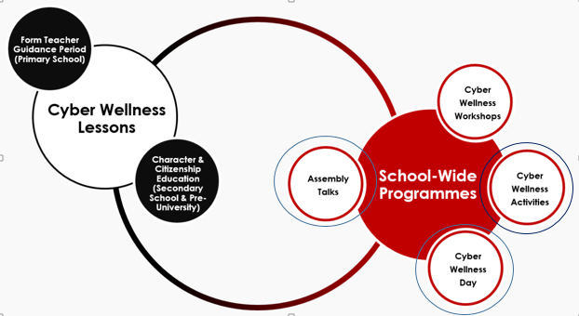
COLLABORATORS
Ministry of Education
  Our Internet safety campaign falls under the “Social
  and Emotional Learning” as part of school programmes.
  Focuses on:
    Skills to manage self, relate to others positively
    and make responsible decisions.
    Maintain a positive presence in cyberspace
    Be a safe and responsible user of ICT.
Infocomm and Media Development Authority (IMDA): A statutory board in Singapore that regulates data protection in Singapore - partner to ensure safe content.
Media Literacy Council: Developing public awareness and education programmes relating to media literacy and cyber wellness.
KidZania Singapore: venue location (for alternative plan): apply what they have learnt so that they know how to react in real life situation,
Cyber Wellness. (n.d.). Retrieved January 31, 2017, from https://www.moe.gov.sg/education/programmes/social-and-emotional-learning/cyber-wellness
Notes:
shah

Slide 7


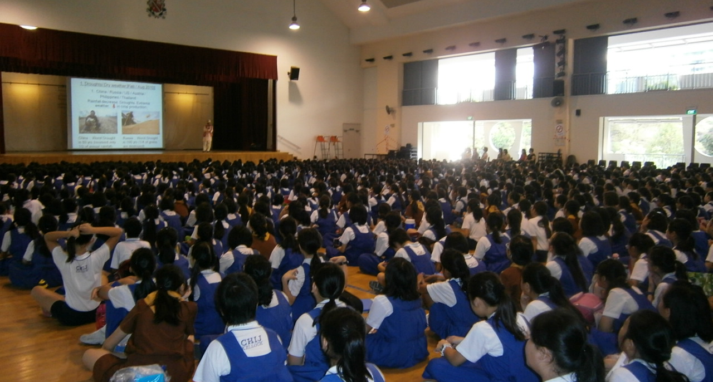

INTEGRATED MARKETING COMMUNICATION STRATEGIES (IMC)
Public Relations
Interactive Media
Personal Selling
Main event
Local influencer: TheSmartLocal
No. 1 Lifestyle Portal in Singapore.
Facebook
YouTube
Instagram
Twitter
For Outreach - Roadshows and assembly talks in Primary & Secondary schools.
Interactive role-play event at Google campus.
Alternative plan: KidZania.
Notes:
Sharon

Slide 8
IMC STRATEGIES
Public Relations: Get local influencers to promote #FindThatX on their video content and invite them over for our events.
Interactive Media:
Primary audience: Instagram, YouTube and Twitter.
Secondary audience: Facebook, YouTube and Instagram.
Video: eXit promotional video
Personal Selling: Roadshows and Assembly talks in school.
Main Event: Interactive role-play event at Google campus.
Back up plan: Liaising with KidZania for our interactive event.
Notes:
We tkplan to use MOE’s Edusave plan to subsidy the admission fee (due to insufficient budget).

Slide 9

PUBLIC RELATIONS
Collaborate with TheSmartLocal to incorporate the idea of #FindThatX in their video content (sponsored).
29th most subscribed YouTuber in Singapore.
Previously worked with Google.
1.1M unique website visitors.
Facebook: 242,000+, YouTube: 116,349, Instagram: 49,000+.
Target audience: Singaporean youths and parents
Video content: Lifestyle and travel content for Singaporeans.
Specialises in:
  Campaign conceptualisation, Editorial Coverage, Video production & promotion (YouTube, Facebook), Influencer marketing.
Video examples: word on the street, vlogs etc.
Notes:
By having Internet safety elements in their video storyboard, interacting with public, it will enforce the idea of staying safe on the Internet to their target audience.

Slide 10
INTERACTIVE MEDIA
 | Primary audience (Youths) | Secondary Audience (Parents)
Facebook | NA - not best platform to advertise. | Video - a kid being threatened by a stranger online and solutions for it.
Instagram | Pictures - Publicise main event, e-posters. Videos - Snippets of our Youtube video. | Pictures - Publicise main event, e-posters Videos - Various videos showing ways to stay secure. E..g. animation on how to avoid dangers on the Internet.
Twitter | Polls - Facts about Internet safety issues. Pictures - Publicise main event, e-posters. | NA - not the best platform to reach parents.
YouTube | #FindthatX series – collaborate with Youtuber to give advice on how to prevent from being involved in internet danger E.g.: 5 types of hackers on the Internet. | #XItToSaveYourChild series - every episode has a lesson for parents to protect their child from Internet danger. E.g. show a kid being extort, then wind back and do the necessary things to prevent it from happening.

Slide 11
VIDEO: eXit
Our video will showcase that even when browsing the internet casually, people are prone to Internet Risks.
It also aims to show our main theme which is “FindThatX”
It also aims to act as a trailer which will attract our target audience to watch our YouTube series and attend our main event.
Notes:
By having Internet safety elements in their video storyboard, interacting with public, it will enforce the idea of staying safe on the Internet to their target audience.
sharon

Slide 12
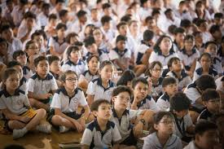
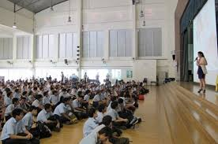
PERSONAL SELLING
Get MLC representatives to go out to at least 50 primary and secondary schools during their assembly period to give talks to the students about Internet safety
Set up roadshow booths within the premises of the schools. Roadshows will aim to raise internet safety awareness by having:
Interactive game booths
Lucky draw
QnA giveaways
Notes:
By having Internet safety elements in their video storyboard, interacting with public, it will enforce the idea of staying safe on the Internet to their target audience.

Slide 13
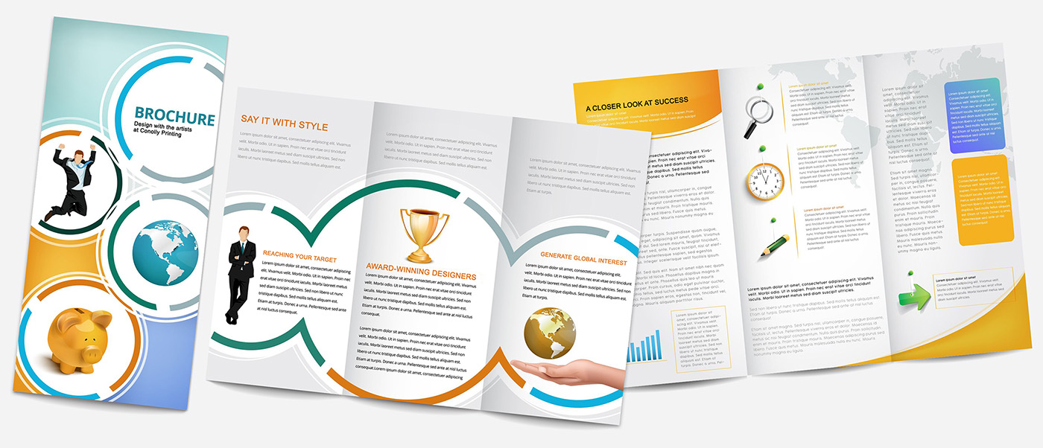

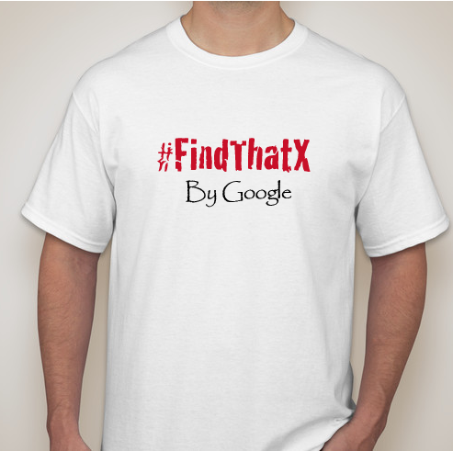

PERSONAL SELLING Goodie bag
Brochures about internet safety & our main event
Notes:
By having Internet safety elements in their video storyboard, interacting with public, it will enforce the idea of staying safe on the Internet to their target audience.

Slide 14
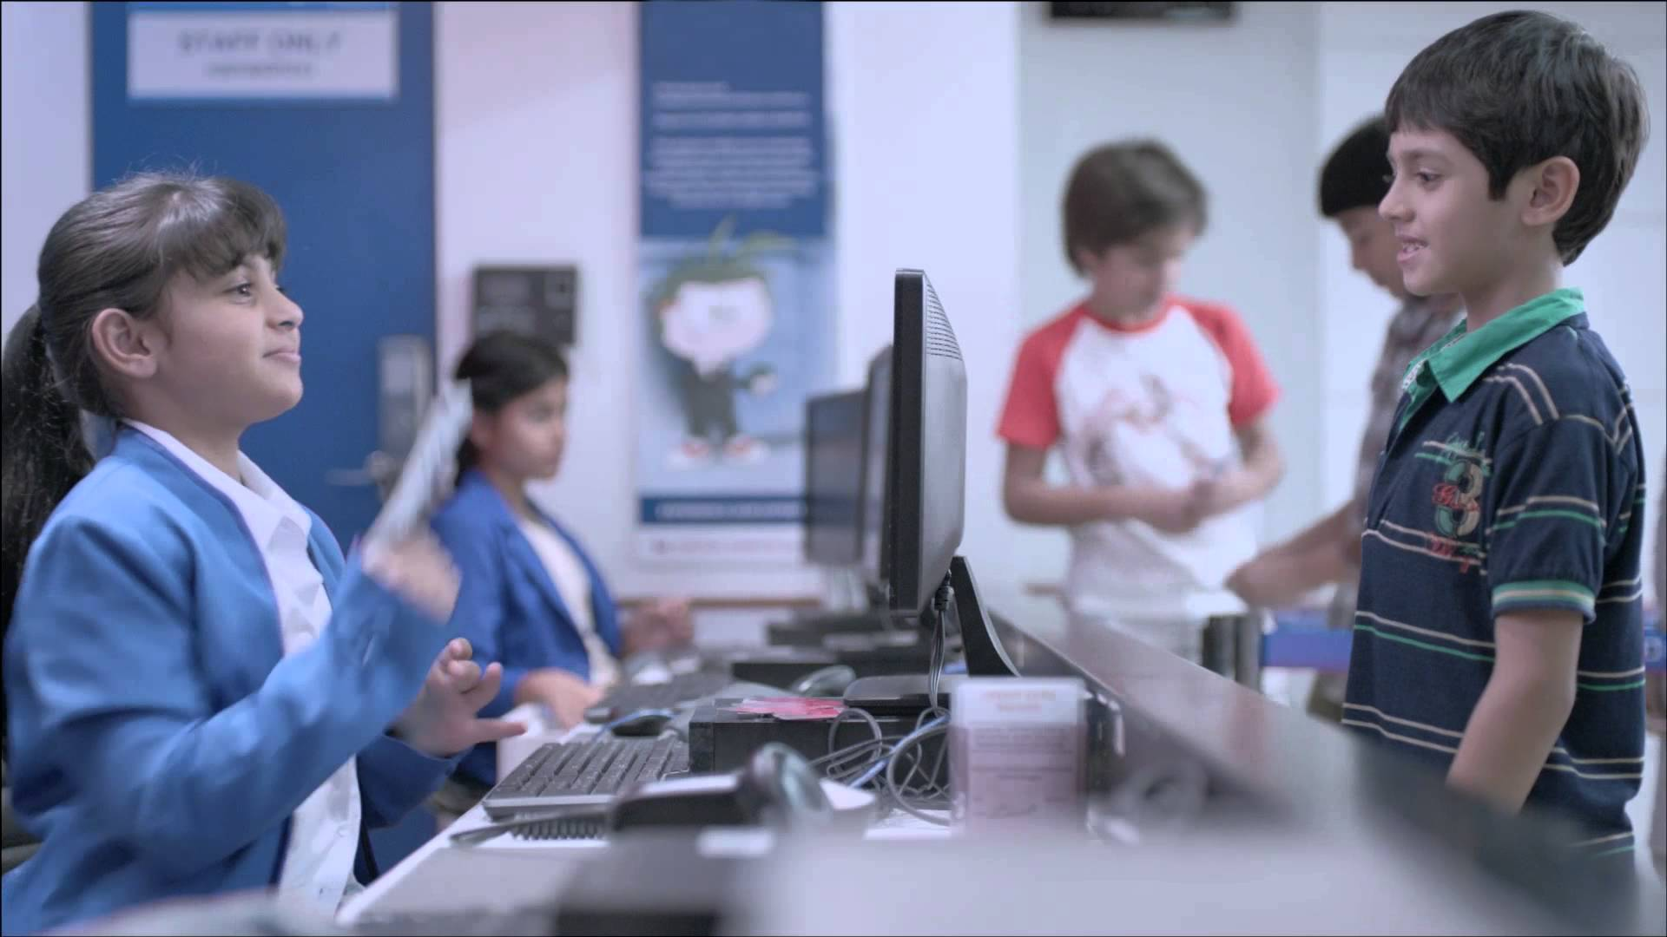
#XPLOREGOOGLE
MAIN EVENT
Plan: Interactive role-play event where kids can learn about Internet safety and take on roles as internet safety advisors.
Venue: Google campus - an indoor area big enough to cater to 3,000 people.
We plan to conduct this event in phases, selecting schools from one district: North - 5 Primary and 5 Secondary schools.
158 Primary schools in Singapore | Primary (one cohort): Avg 6 classes x 40 per class = 240 people. 240 people x 5 schools = 1,200 people.
163 Secondary schools in Singapore | Secondary (one cohort): Avg 7 classes x 40 per class = 280 people. 280 people x 5 schools = 1,400 people.
Volunteers: Google staff and Republic Polytechnic students.
Booths: Games and merchandise.
One-time setup of tentature and booths so save costs for the next few phases.
Notes:
How many days

Slide 15
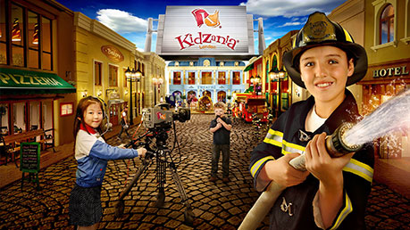
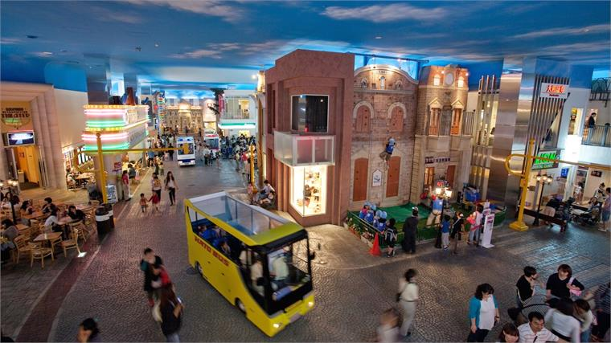
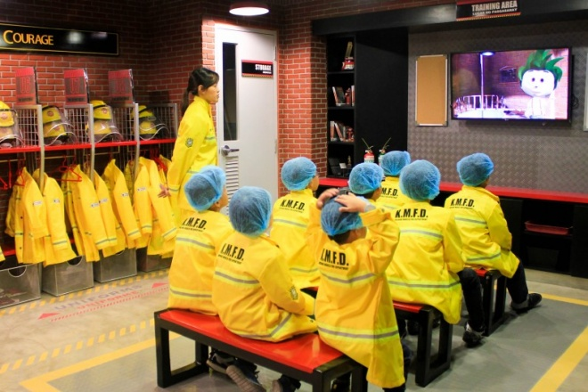
#XPLOREKIDZANIA
ALTERNATIVE PLAN
Liaise with KidZania (event location)
Have mini pop-up booths at the event.
Experience interactive role-play in a live-sized city.
Build a digital Internet set - a series of games where MLC representatives teach them about Internet risks and how to prevent them.
Apply what they have learnt by dealing with “real life online threats”.
There will be mockup “Cyber-bully victims” and the kids will take on the role as Internet Safety advisors.

Slide 16
WHAT’S IN IT FOR KIDZANIA?
Increase profit - gains popularity among kids and parents who didn’t know about KidZania previously.
Build reputation as a good learning space, besides the fun factor.
Benefits of sponsorship - collaboration with Google and MOE.
Not well known, only opened 2 years ago.
Notes:
sharon

Slide 17
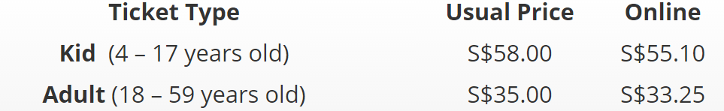
BUDGET FOR KIDZANIA:
ADMISSION FEES
Price for the ticket:
We plan to use MOE’s Edusave plan to subsidy the admission fee (due to insufficient budget) as it is part of MOE’s social and emotional learning.

Slide 18
EVENT TIMELINE
PHASE 2
Jan/Feb 2018
9 Jan - 12 Feb
PHASE 1
Dec/Jan 2017
26 Dec - 8 Jan
Constant update on social media platforms.
School assemblies and mini roadshows in school - rallying awareness for main event.
Partners to publish their sponsored content.
Execution of the main event with KidZania.
PHASE 3
Feb 2018
13 - 28 Feb
Blast of content across social media as pre-publicity to kickstart
the hype.
Liaising with partners for video shoot and content creation.
Logistics for Phase 2.
Recce of event space and roadshows/talks in schools.
Review of media impressions and marketing efforts.
Social media analytics - likes, shares and comments.
Tabulation of total turnout rate for event and increase in social media accounts.

Slide 19
EVENT TIMELINE
1 week event: 6 - 12 February (7th being Internet Safety Day)
11am - 3pm (4 hours)
10:30am | Registration.
11.00am - 11.30am | Safety briefing & official launch by KidZania & Google officials.
11.30am - 12.30pm | Start off for the games (in accordance with staying safe on the internet etc. Treasure hunt for the “X” button, filling up trivias for internet safety
12.30pm - 2.30pm | Start of the role playing as Internet Safety advisors helping the “victims” who are affected.
2.30pm - 3pm | Debrief and dismissal

Slide 20
BUDGET
No. | Item: | Description: | Cost: | Quantity: | Subtotal Total:
 | Online Advertising | Posting posters on IMDA, MLC ad our own #FindthatX Pages | Free | 2-3 times a week across all social media platforms. | $0
2. | TheSmartLocal (PR) | Tailoring their video content in accordance to our campaign | Tbc | Tbc | Tbc
3. | Volunteers at event | Volunteers will facilitate the logistics and programme at the event site. | Free - CCE points + LOA given | 50 per day. 50 x 7= 350 Volunteers total. | $0
4. | KidZania | Propose to MOE to subsidy under learning journey/ | $58 per ticket | Targeted at 2000 pax | $116,000
5. | Goodie Bag | To be given during talks and roadshows | $2 | 300 goodie bags will be given out to students during assembly talks. | $600
6. | Food | For volunteers. | $3.50 | One per volunteer. | $1,225
7. | Booth setup | For Google main event. | $5000 |  | $5,000
Total current budget:
$6,825
Amount left for collaboration with TheSmartLocal:
$35,760

Slide 21
CAMPAIGN EVALUATION
Interactive Marketing | Social media analytics and Media monitoring: Likes, Shares, Comments, Follower count on #FindThatX social media handles. Bounce rates. YouTube video: session duration. (Qualitative & Quantitative)
Public Relations (PR) | Using AVE to analyse how much we have earned. (Quantitative)
Personal Selling | Number of students present in the assembly.(Quantitative) Feedback form after the assembly (Qualitative)
Main event | Number of people who attended the event. (Quantitative) Feedback form after the event. (Qualitative)

Slide 22
APPENDICES

Slide 23
TARGET AUDIENCE ANALYSIS: Audience Demographics
 | Primary Audience: Youths |  | Secondary Audience: Parents of youths
Demo graphic | Age | 9 - 14 | Age | 30 and above
 | Gender | Male and Female | Gender | Male and Female
 | Location | Singapore | Location | Singapore
 | Marital status | Single | Marital status | Single, Married, Divorced.
 | Occupation | Student | Occupation | Employed, unemployed
 | Income: | None | Income | $1,000 and below $1,001 - $5,000 $5,001 - $10,000 $10,000 and above
 | Education level | Primary to Secondary | Education level | PSLE-PhD
 | Nationality | Citizens, PR, foreigners. | Nationality | Citizens, PR, foreigners.

Slide 24
TARGET AUDIENCE ANALYSIS: Audience Psychographics
 | Primary Audience: Youths | Secondary Audience: Parents of Youths
Virtual trend | High social media consumption on Facebook, Twitter, Instagram. Online video gaming. | High consumption on Facebook. Watching videos and shows. Search engines for work purposes.
Bad habits | Easily influenced. Cyber bullying. Downloading any game files from the web without checking the credibility. | Share too much information online without sieving out if it contains virus
Internet dangers | Fine line between personal & public. Virus download. Prone to cyberbullying, privacy and identity theft. Inappropriate content. | Fine line between personal & public, Virus download. Prone to privacy and identity theft. Radicalisation.

Slide 25
SITUATIONAL ANALYSIS
Strengths | Weaknesses
Largest internet advertising company in the world by annual revenues. Strong brand presence (70% of world’s queries). Owns Android (80% of the world are Android users. | Vulnerable to fluctuating demand for advertisements since 90% of revenues come from ads (Overdependence on ads) Google's Cost-Per-Click fell 7% annually, compared to a 3% decline in the fourth quarter of 2014.
Opportunities | Threats
Has established organisations under them: YouTube, Maps, Drive, Gmail etc. Has the capacity to potentially work with other big companies in the world. Diversification into non-Ad Business Models. | Main revenue is advertisments but competitors are more successful in portraying ads. Competitors: Facebook, Amazon and Apple. Google isn’t known for huge impactful campaigns.
Sun, L. (2015, July 03). SWOT Analysis of Google Inc. Retrieved January 31, 2017, from http://www.fool.com/investing/general/2015/07/03/swot-analysis-of-google-inc.aspx

Slide 26
5Cs
Company: | Google is known as a credible and reliable company. It has tried coming up with other Internet Safety Campaigns previously.
Customers: | Primary: Kids aged: 9-14 Secondary :Adults aged: 30 and above.
Competitors: | Facebook, Yahoo and Apple as they have carried out similar campaigns.
Collaborators: | IMDA, Media Literacy Council, Kidzania, MOE
Climate: | Competitive climate as there have been many Internet Safety Campaigns here in Singapore.
Notes:
Sharon

Slide 27
APPENDICES:
EXTENSIVE
RESEARCH

Slide 28
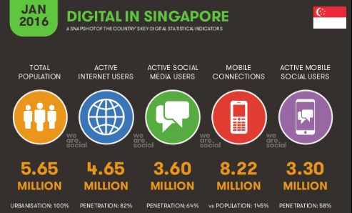
82% penetration - highest in the world,
increasing our risks to Internet danger.
Digital in 2016. (n.d.). Retrieved January 23, 2017, from http://wearesocial.com/sg/special-reports/digital-2016
Notes:
By having Internet safety elements in their video storyboard, interacting with public, it will enforce the idea of staying safe on the Internet to their target audience.

Slide 29
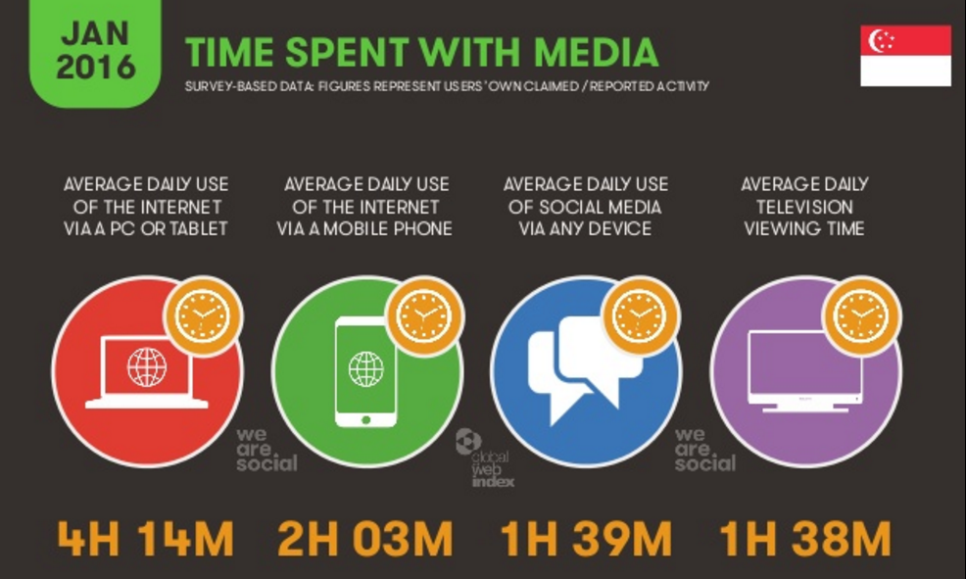
Highest average use of the Internet is on the PC or tablet,
so we plan to use IMC tools that leverage on them.
Digital in 2016. (n.d.). Retrieved January 23, 2017, from http://wearesocial.com/sg/special-reports/digital-2016

Slide 30
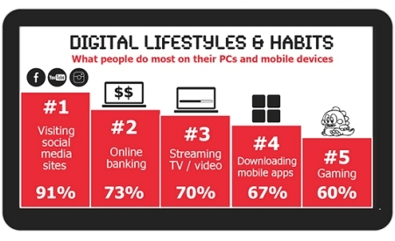
Top 5 digital habits of Singaporeans, making them
vulnerable to cybercrimes.
Digital in 2016. (n.d.). Retrieved January 23, 2017, from http://wearesocial.com/sg/special-reports/digital-2016

Slide 31
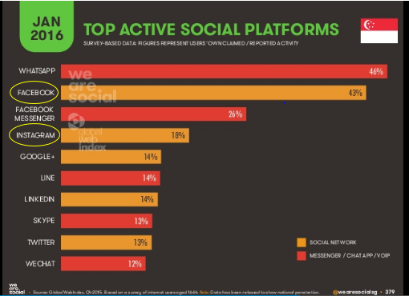
Facebook and Instagram are the top 2 social networking
sites in Singapore, which are the 2 we plan to use.
Digital in 2016. (n.d.). Retrieved January 23, 2017, from http://wearesocial.com/sg/special-reports/digital-2016
Notes:
sharon

Slide 32
THANK YOU!
M333 DAY 1 CLASS
TEAM 3 | Christie Foong, Shah Indra, Sharon Elango, Teck Kuan Teo.

